Slide 1
Kaggle’s Churn Analysis Challenge
By Graham Herdman
Notes:
I just realized that I have quite a few slides so you can hurry me up when ever you feel like it but I wanted to make sure I was thorough in analyzing this data set.

Slide 2
Goals
Identify the maximum accuracy we can achieve for predicting whether a customer will churn and discover which machine learning model will allow us to achieve this.
Notes:
NOTE: Main Focus Was On EDA Because That Was What Was Mentioned In The Email

Slide 3
Goals
Identify the maximum accuracy we can achieve for predicting whether a customer will churn and discover which machine learning model will allow us to achieve this.
Identify the top 5 features that hold the most prediction power in relation to customer churn rate.
Notes:
NOTE: Main Focus Was On EDA Because That Was What Was Mentioned In The Email

Slide 4
Goals
Identify the maximum accuracy we can achieve for predicting whether a customer will churn and discover which machine learning model will allow us to achieve this.
Identify the top 5 features that hold the most prediction power in relation to customer churn rate.
(hopefully) Impress my audience so that I can get this job!
Notes:
NOTE: Main Focus Was On EDA Because That Was What Was Mentioned In The Email

Slide 5
Data Set Description
3333 Entries
Notes:
NOTE: Main Focus Was On EDA Because That Was What Was Mentioned In The Email

Slide 6
Data Set Description
3333 Entries
21 Features
Notes:
NOTE: Main Focus Was On EDA Because That Was What Was Mentioned In The Email

Slide 7
Data Set Description
3333 Entries
21 Features
6 Categorical Features
14 Numeric Features
1 Class Variable (Binary)
Notes:
NOTE: Main Focus Was On EDA Because That Was What Was Mentioned In The Email

Slide 8
Data Set Description
6 Categorical Features
State (Categorical)
Area Code (Categorical)
Phone Number (Categorical)
International Plan (Binary)
Voice Mail Plan (Binary)
Customer Service Calls (Ordinal)
Notes:
NOTE: Main Focus Was On EDA Because That Was What Was Mentioned In The Email

Slide 9
Data Set Description
6 Categorical Features
State (Categorical)
Area Code (Categorical)
Phone Number (Categorical) <- Irrelevant
International Plan (Binary)
Voice Mail Plan (Binary)
Customer Service Calls (Ordinal)
Notes:
NOTE: Main Focus Was On EDA Because That Was What Was Mentioned In The Email

Slide 10
Data Set Description
5 Categorical Features
State (Categorical)
Area Code (Categorical)
International Plan (Binary)
Voice Mail Plan (Binary)
Customer Service Calls (Ordinal)
Notes:
NOTE: Main Focus Was On EDA Because That Was What Was Mentioned In The Email

Slide 11
Data Set Description
3333 Entries
20 Features
6 Categorical Features
14 Numeric Features
1 Class Variable (Binary)
Notes:
NOTE: Main Focus Was On EDA Because That Was What Was Mentioned In The Email

Slide 12
Data Set Description
14 Numeric Features
Account Length
Number Vmail Messages
Total Day Minutes
Total Day Calls
Total Day Charge
Total Eve Minutes
Total Eve Calls
Total Eve Charge
Total Night Minutes
Total Night Calls
Total Night Charge
Total Intl Minutes
Total Intl Calls
Total Intl Charge
Notes:
NOTE: Main Focus Was On EDA Because That Was What Was Mentioned In The Email

Slide 13
Data Set Description
5 Numeric Features (Aggregated)
Account Length
Number Vmail Messages
Total Minutes
Total Calls
Total Charge
Notes:
NOTE: Main Focus Was On EDA Because That Was What Was Mentioned In The Email

Slide 14
Data Set Description
3333 Entries
21 Features
6 Categorical Features
14 Numeric Features
1 Class Variable (Binary)
Notes:
NOTE: Main Focus Was On EDA Because That Was What Was Mentioned In The Email

Slide 15
Data Set Description
1 Label Variable
Churn
Notes:
NOTE: Main Focus Was On EDA Because That Was What Was Mentioned In The Email

Slide 16
Data Set Description
3333 Entries
21 Features
6 Categorical Features
14 Numeric Features
1 Class Variable (Binary)
No Nulls or missing values
Notes:
NOTE: Main Focus Was On EDA Because That Was What Was Mentioned In The Email

Slide 17
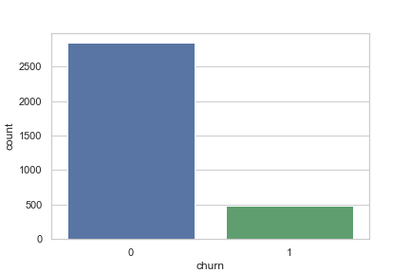
Categorical Features – Univariate

Slide 18
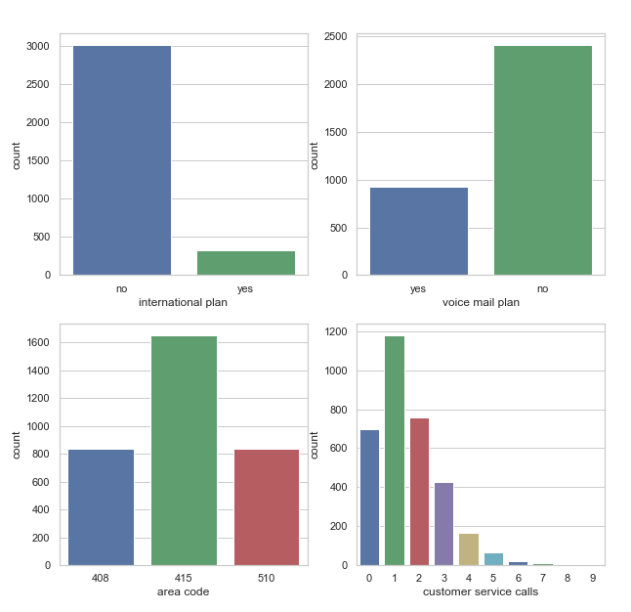
Categorical Features – Univariate

Slide 19
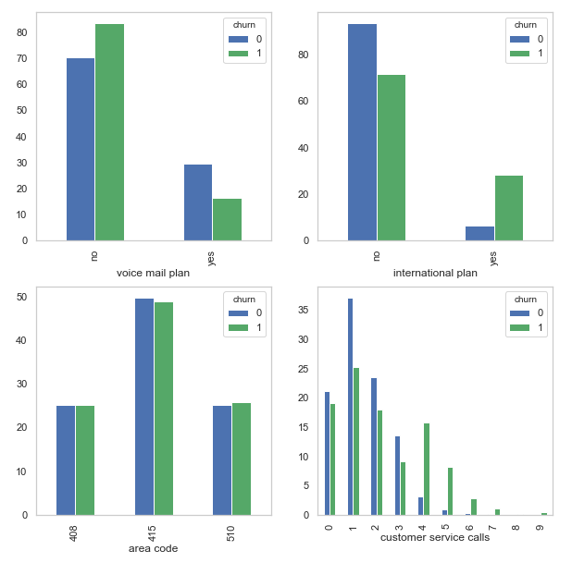
Categorical Features – Relationship To Churn, Adjusted

Slide 20
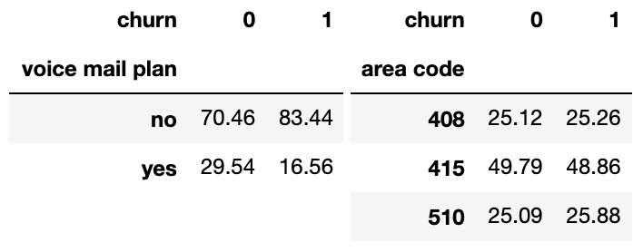
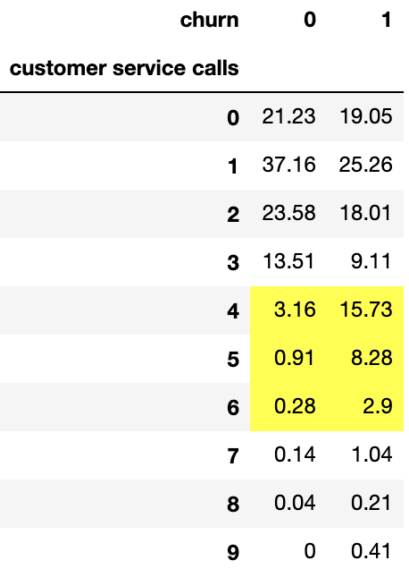
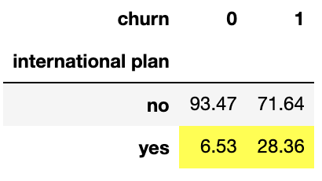
Categorical Features –Relationship To Churn, Adjusted
Notes:
The proportion of people who churned was 4 times as high as loyal customers when they opted for the international plan

Slide 21
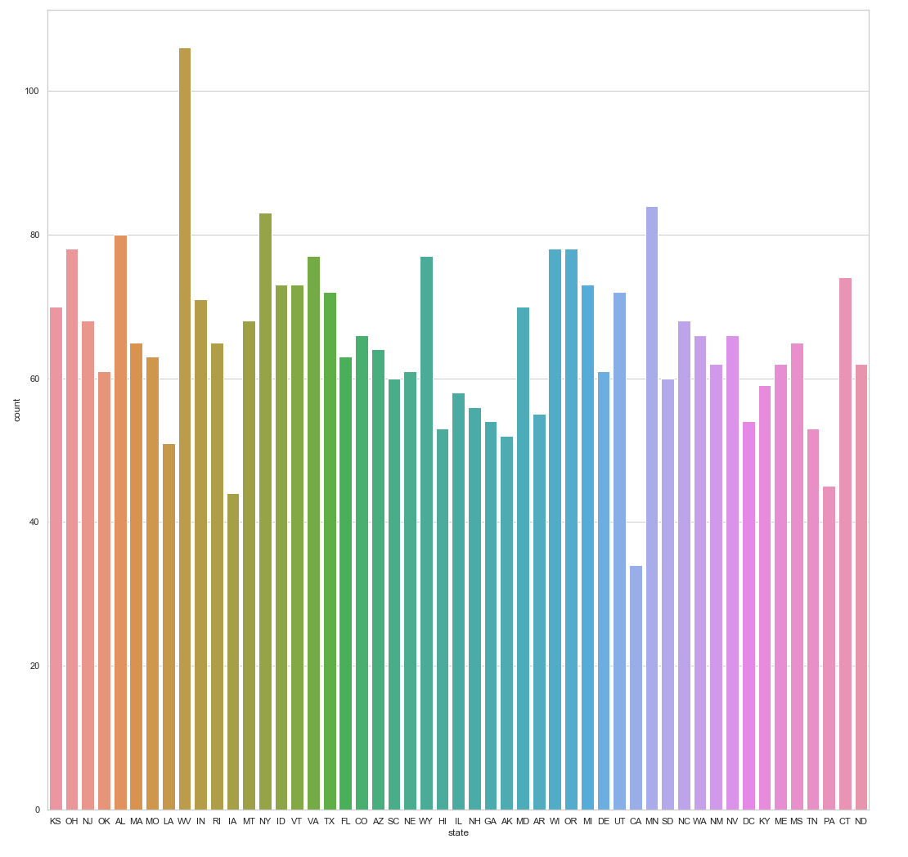
Categorical Features – Univariate
State

Slide 22
Categorical Features – Relationship To Churn, Adjusted

Slide 23
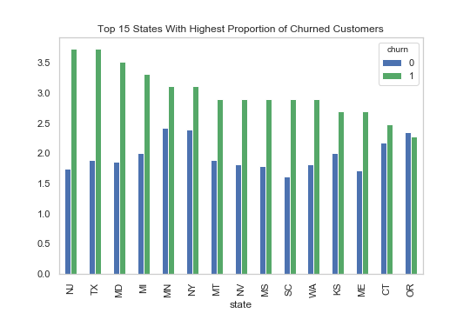
Categorical Features –Relationship To Churn, Adjusted

Slide 24
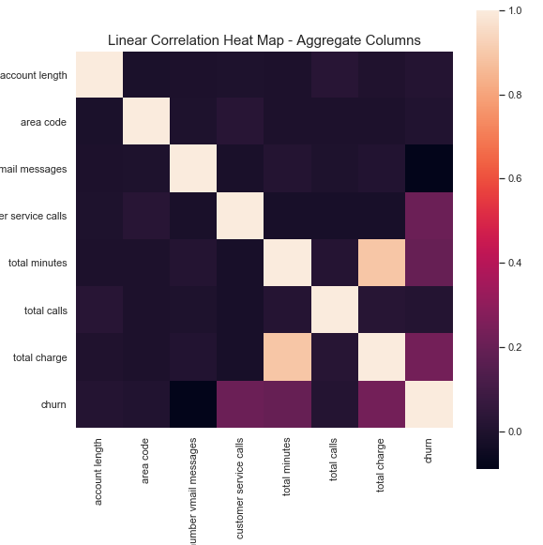
Heatmap: Aggregate Totals
Notes:
After analyzing the categorical variables I then looked at a heat map which shows the linear correlations between numeric variables in the data set.
Large Correlation between total minutes and total charge
Many machine learning models assume independence of the different features
Removed total minutes
Total charge and customer service calls
Included them when conducted feature selection

Slide 25
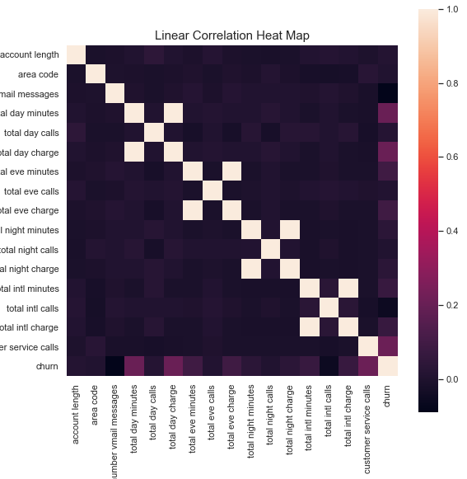
Heatmap: Aggregate Totals
Notes:
Here you can see that what accounts for the correlation between total minutes and total charge are largest in the day.

Slide 26
Numeric Features: Mean Values
Notes:
The median values were very similar meaning these variables were normally distributed which is good to know because most machine learning algorithms assume this.

Slide 27
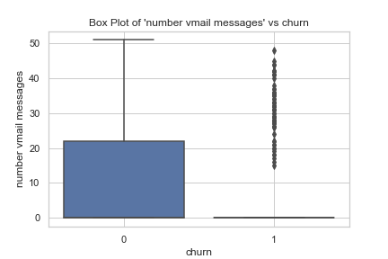
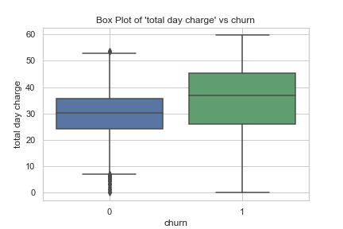
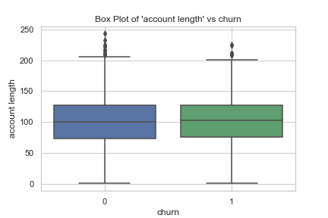
Numeric variables: Box plots
Notes:
So instead of talking about all 14 numeric variables I Chose 3 of the most interesting to talk about.

Slide 28
Baseline Accuracy For Our Models
Baseline 1: 85.51%
Rule: Choose Majority Class (Loyal)
Baseline 2: 85.81%
Rule: if (Customer Service Calls > 3) & (International Plan == True) ==> churn=1, else: churn=0
Baseline 3: 86.32%
Rule: if (Customer Service Calls > 3) & (in_top_15_states == True) ==> churn=1, else churn=0
Notes:
Incorporating more information from the exploratory data analysis each time
Tried

Slide 29
Models Used
Logistic Regression
Random Forest
Gradient Boosting

Slide 30
Performance Evaluation
Notes:
We can see that Gradient Boosting was able to Generalize a lot better than the rest of the algorithms because of it’s high resistance to bias
Unfortunately I tried incorporating Feature Selection but I couldn’t get the models to perform better than on the entire data set

Slide 31
Conclusion
- Maximum Accuracy Achieved: 94.96%
- ML Algorithm: Gradient Boosting
1. Customer Service Calls
2. Total Day Charge
3. International Plan
4. In Top 15 States
5. Total Eve Charge
Hopefully?
Notes:
NOTE: Main Focus Was On EDA Because That Was What Was Mentioned In The Email

Slide 32
Improvements For The Future
Greater Feature Selection
PCA
01
XGBoost
02
Look into the features RF and GB chose
03
AUC charts
04
K Folds Cross-Validation
05

Slide 33
Thank you!

